Slide 1
CHAPTER 6
Predictive Control with tracking 3 utilising feedforward in GPC
Anthony Rossiter

Slide 2
Background
The first video reminded viewers that a default MPC approach uses future values for the target.
However, a typical MPC algorithm seems to behave worse when more accurate target information is provided.
This chapter demonstrates simple techniques for making better use of feed forward information within a GPC algorithm.

Slide 3
Background insights
Demonstrated that although the default definition of GPC includes information about future targets, it does not use this information wisely.
The use of a finite (often small) control horizon means that the class of available input predictions are not in an appropriate position to track target changes which appear much further ahead within the prediction.

Slide 4
Basic insight
In order to track a future target change, the best place for the input changes are around the time the target changes.
This means that the amount of future information about the target cannot exceed the control horizon by more than a few samples.
One cannot easily give an analytic definition of the ‘best’ amount of future information, thus some trial and error may be required.

Slide 5
Basic proposal
Assume that the future target information is given as:
Only information up to n_{a} samples in the future can be used usefully, so use:
For convenience define n_{a} as the advance knowledge parameter.

Slide 6
Impact of advance knowledge on control law
The part of the default control law using target information is given as:
Restricting advance knowledge replaces this as follows:
Next combine common terms.

Slide 7
Impact of advance knowledge on control law
Common terms can be combined as follows:
Now the feedforward term has just n_{a} coefficients.
The conjecture is that the best choice for n_{a} is similar to n_{u}, or perhaps one or two samples higher as one knows that some anticipation is nearly always useful.

Slide 8
Examples of using advance knowledge
The remainder of this video will give a number of examples to demonstrate how behaviour changes with advance knowledge n_{a}.
The examples will make it clear that the best value is not fixed in any sense and depends on all the other parameters (output horizon, control weighting and model).
In practice, some form of offline testing is required to identify the most appropriate value for advance knowledge.

Slide 9
video6_3_example1.m
Reducing n_{a} improves behaviour significantly, but it is still better larger than 1.

Slide 10
video6_3_example2.m
Reducing n_{a} improves behaviour significantly, but it is still better larger than 1.

Slide 11
video6_3_example4.m
Reducing n_{a} improves behaviour significantly, but it is still better larger than 1.

Slide 12
Summary
Demonstrated that it is straightforward to exploit a user selected amount of advance information within GPC.
Common sense, backed up by simulations, illustrate the best choice of advance knowledge is in the same region as the choice of control horizon.
The best choice of advance knowledge is usually greater than 1 but much less than the output horizon. It is likely that trial and error is required to make a precise selection.

Slide 13



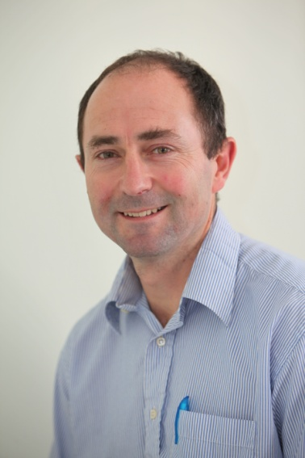
Anthony Rossiter
Department of Automatic Control and Systems Engineering
University of Sheffield
www.shef.ac.uk/acse
© 2014 University of Sheffield
This work is licensed under the Creative Commons Attribution 2.0 UK: England & Wales Licence. To view a copy of this licence, visit http://creativecommons.org/licenses/by/2.0/uk/ or send a letter to: Creative Commons, 171 Second Street, Suite 300, San Francisco, California 94105, USA.
It should be noted that some of the materials contained within this resource are subject to third party rights and any copyright notices must remain with these materials in the event of reuse or repurposing.
If there are third party images within the resource please do not remove or alter any of the copyright notices or website details shown below the image.
(Please list details of the third party rights contained within this work.
If you include your institutions logo on the cover please include reference to the fact that it is a trade mark and all copyright in that image is reserved.)

